Slide 1

Question Everything
(Mempertanyakan Segalanya)
Help everyone to learn faster

Slide 2
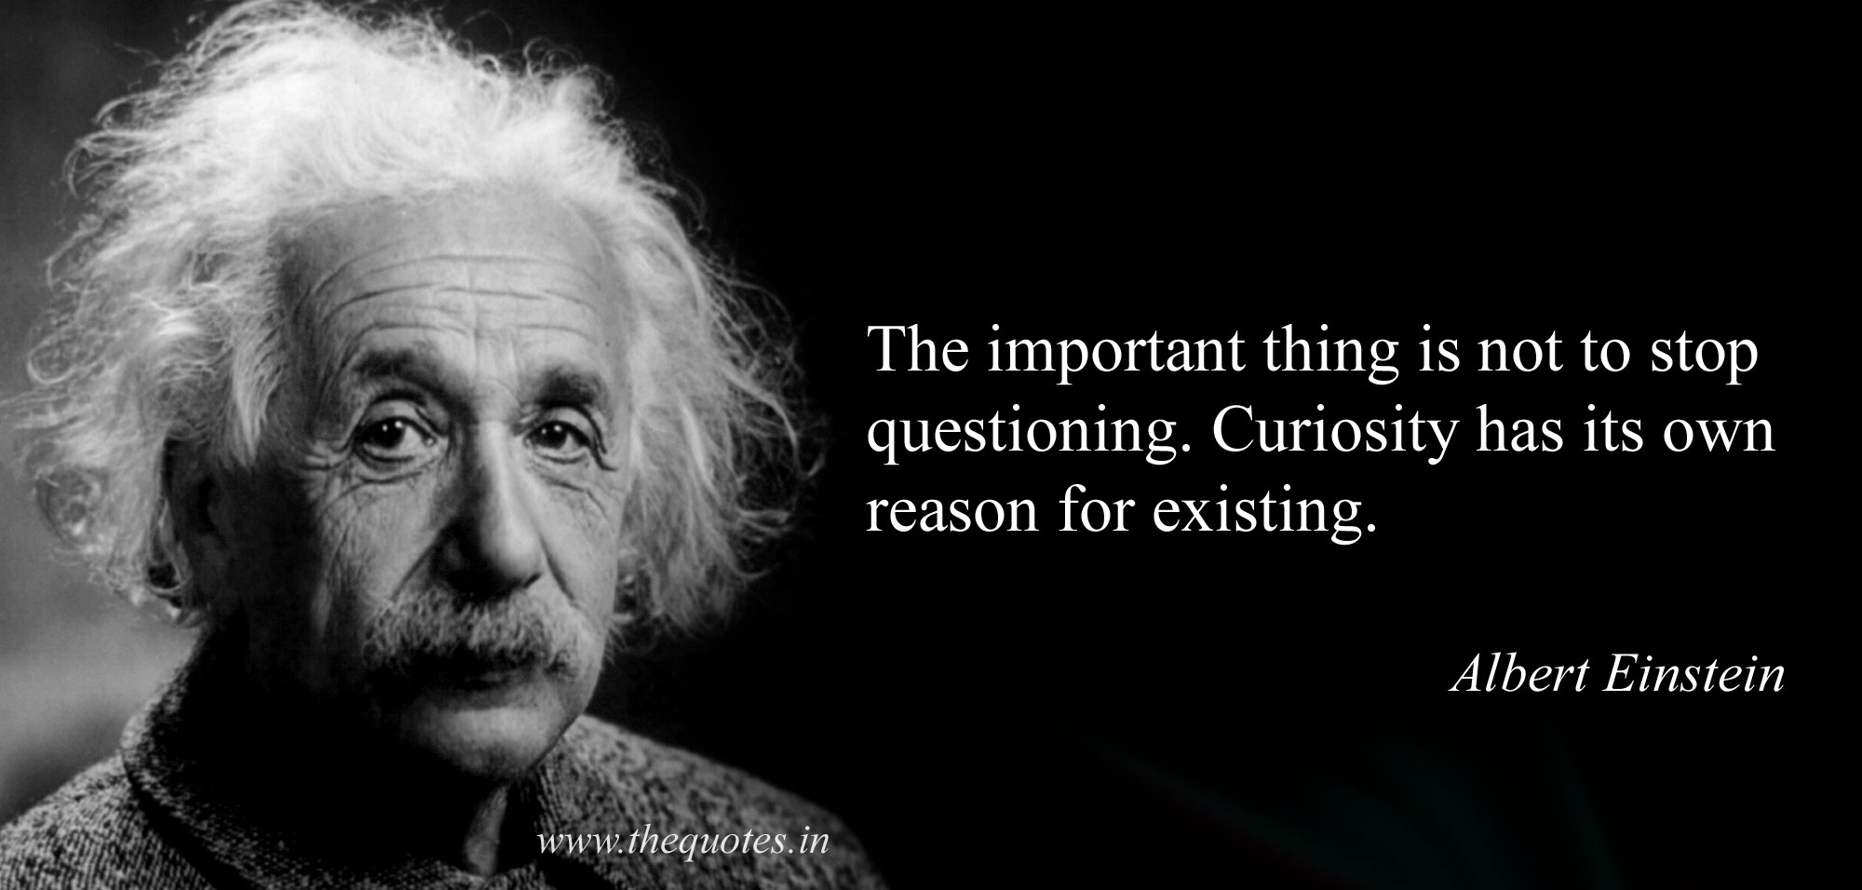
Memicu berpikir
Membunuh asumsi
Help everyone to learn faster

